Slide 1
Task for Digital Marketing Interns: Creating and Managing a Digital Marketing Campaign
Prepared by: Muhammad Asim
Field: Digital Marketing
ID: DHC-341

Slide 2

Week 1:
Research and Campaign Planning
Market Research
○ Identify the target audience for the "Social Connect" app (e.g., age group, interests, demographics).
○ Research competitors and their digital marketing strategies.
○ Identify key marketing channels (e.g., Instagram, LinkedIn, Facebook, Google Ads).

Slide 3
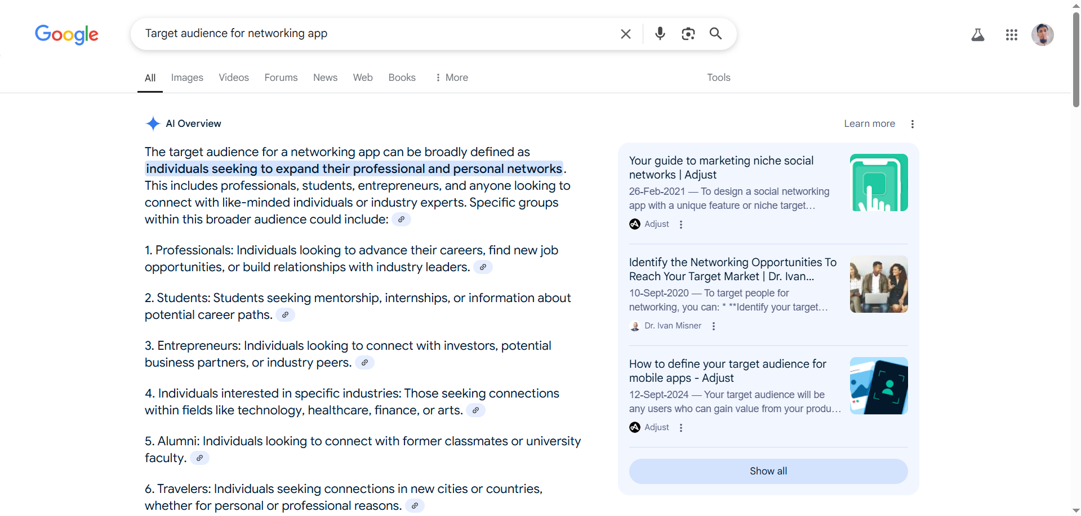
Identify the Target Audience for the "Social Connect" App

Slide 4
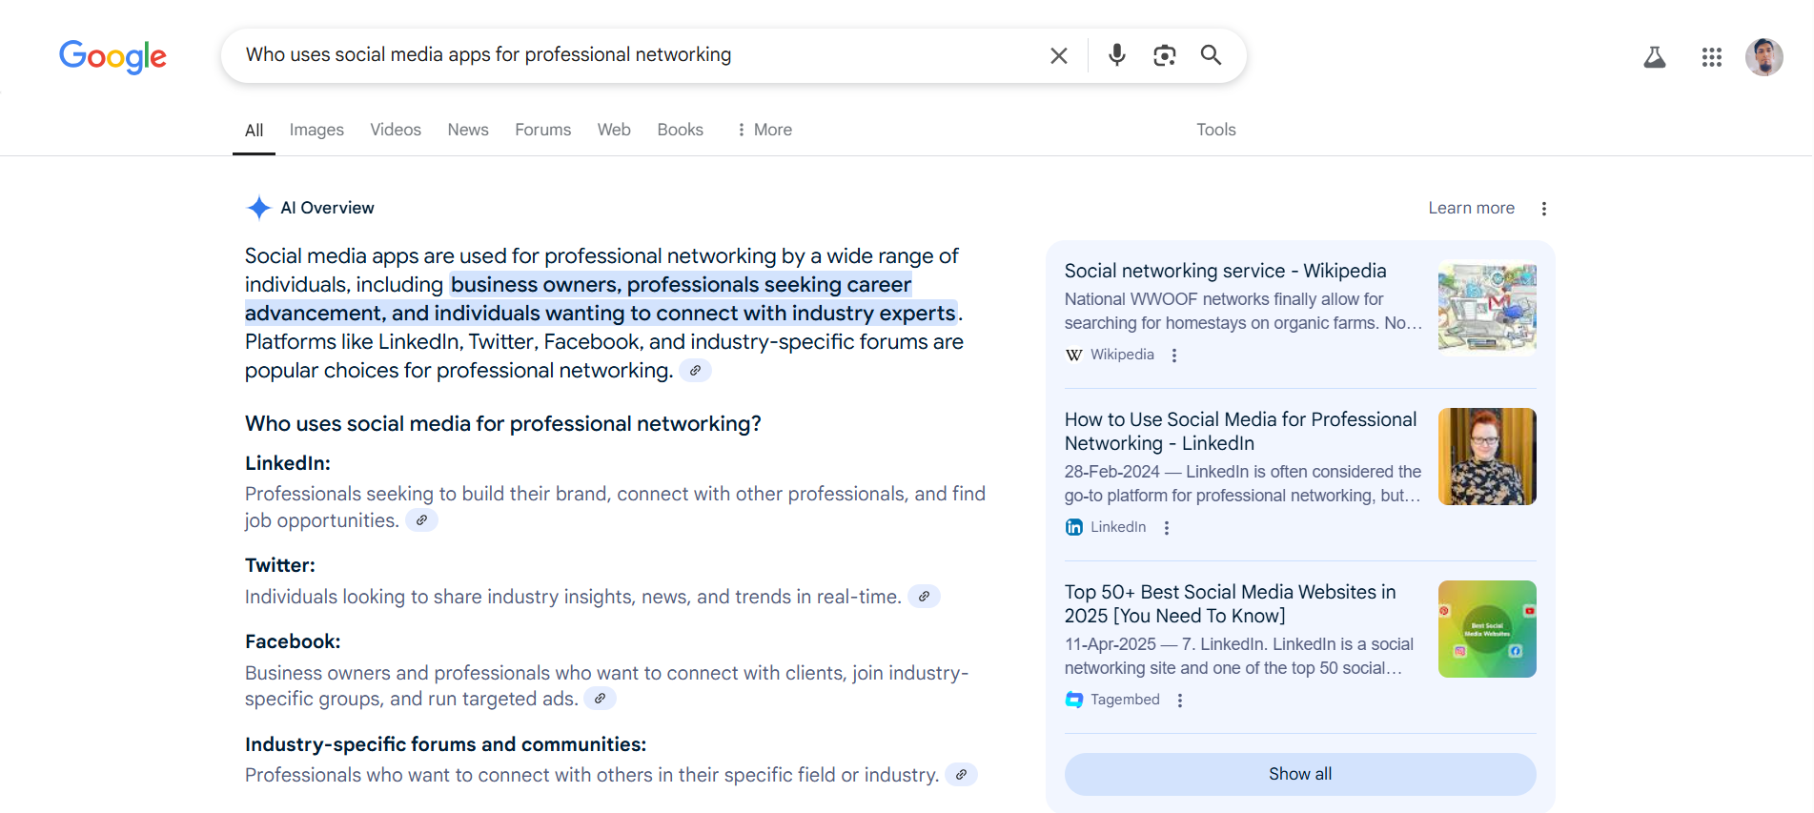
Identify the Target Audience for the "Social Connect" App

Slide 5
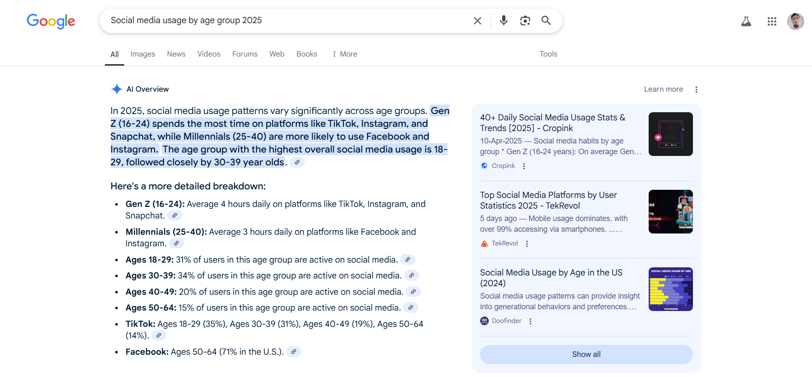
Identify the Target Audience for the "Social Connect" App

Slide 6
Identify the Target Audience for the "Social Connect" App
https://www.statista.com/topics/1164/social-networks/
https://blog.hootsuite.com/social-media-target-audience/
https://www.similarweb.com/top-websites/computers-electronics-and-technology/social-networks-and-online-communities/
https://blog.hubspot.com/blog/tabid/6307/bid/5326/learning-from-leaders-the-inc-500-and-social-media-usage.aspx

Slide 7
Identify the Target Audience for the "Social Connect" App
Based on online research and user behavior trends, the ideal target audience for Social Connect includes:
Age: 18–34 years
Demographics: College students, early-career professionals, freelancers, entrepreneurs
Interests: Networking, personal development, attending events, using productivity tools
Tech behavior: Highly active on Instagram, LinkedIn, and mobile apps

Slide 8
Research Competitors and Their Digital Marketing Strategies
I did research on three competitors:
Bumble BFF
LinkedIn App
MeetUp

Slide 9
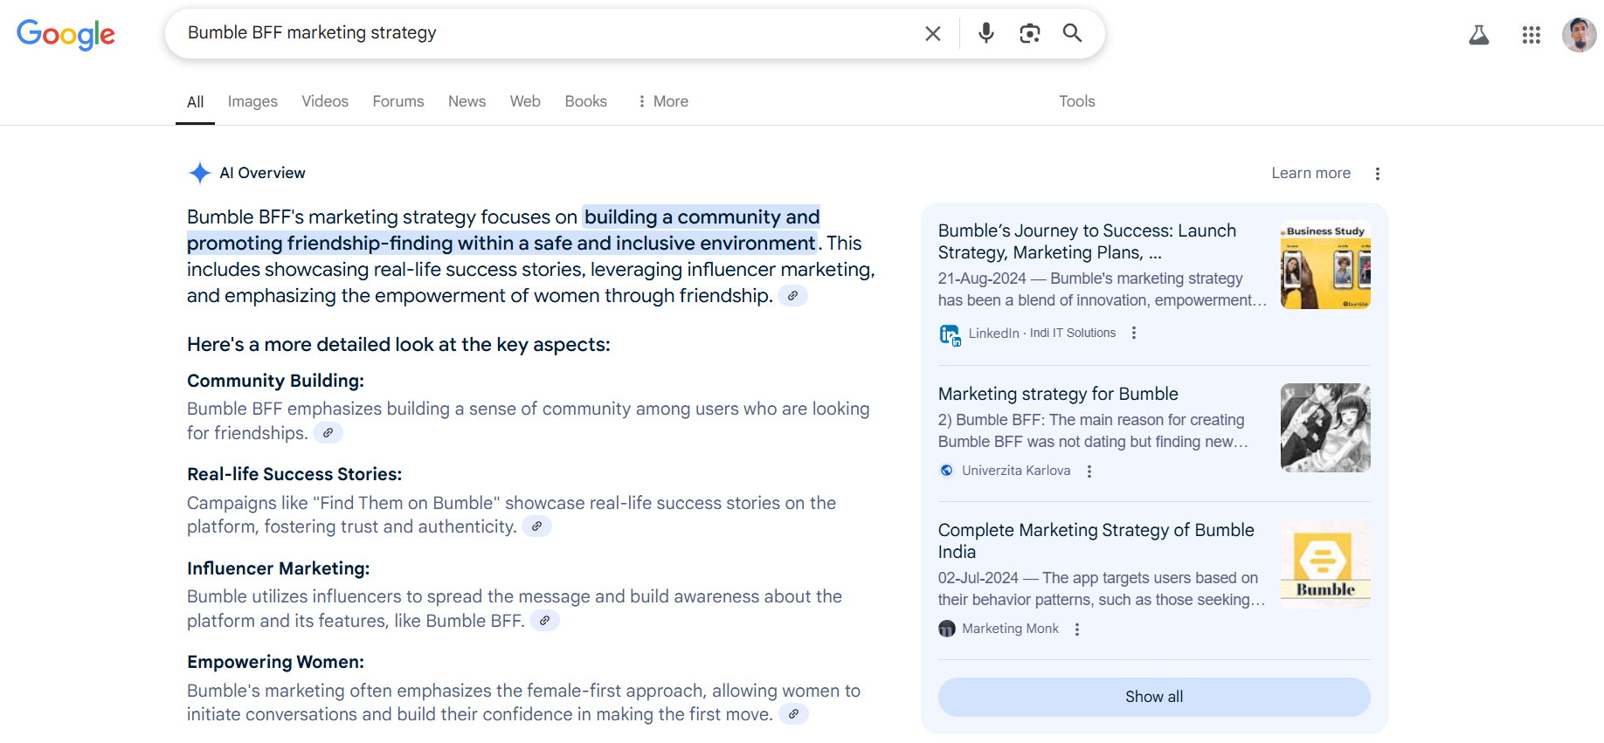
Research Competitors and Their Digital Marketing Strategies

Slide 10
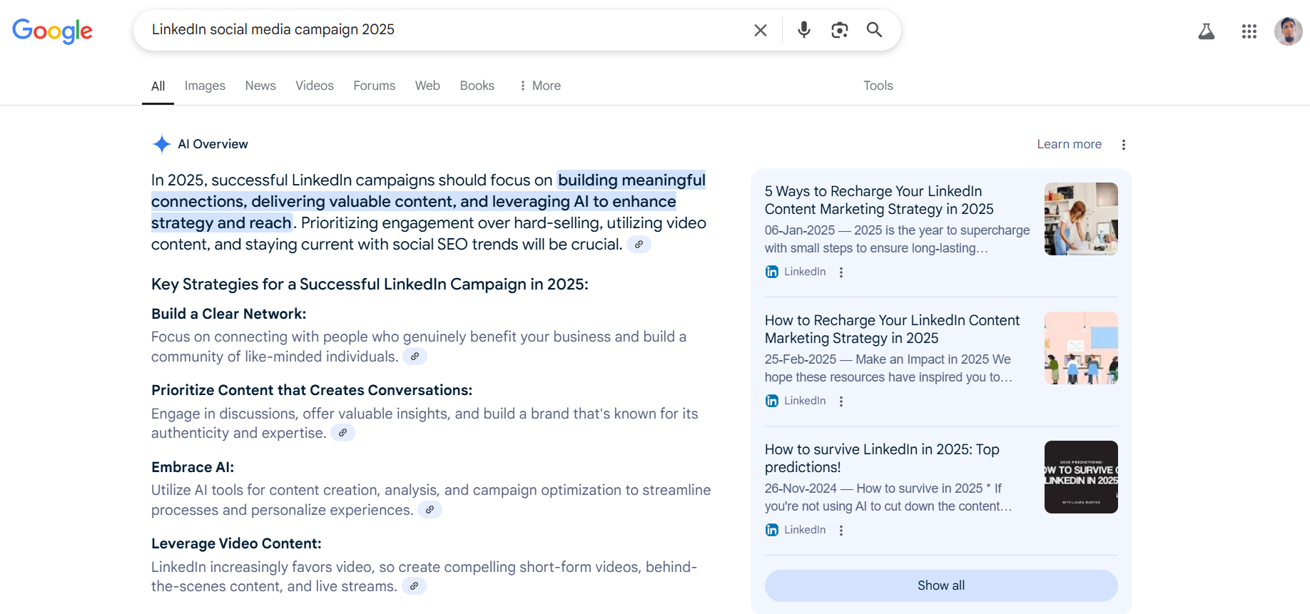
Research Competitors and Their Digital Marketing Strategies

Slide 11
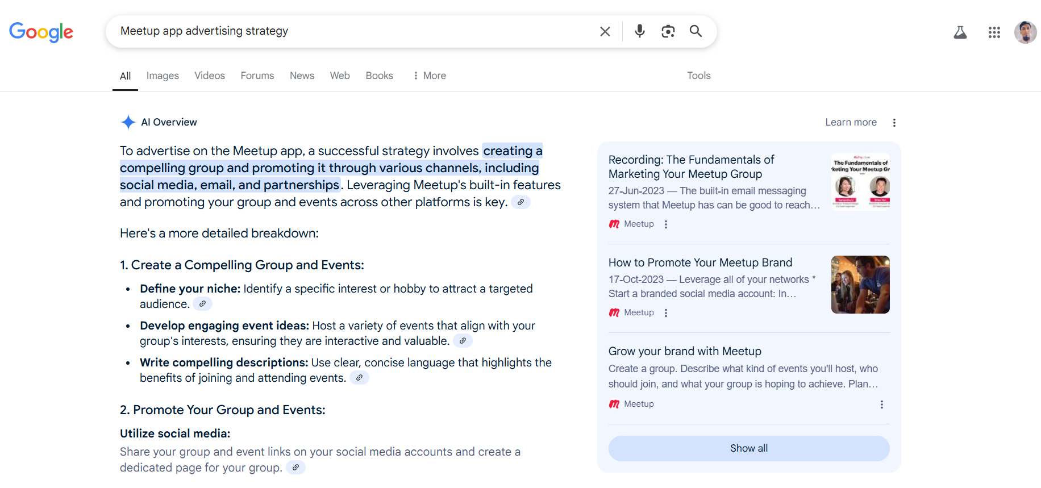
Research Competitors and Their Digital Marketing Strategies

Slide 12
Research Competitors and Their Digital Marketing Strategies
App | Channels Used | Strategy Example
LinkedIn | Blog, Email, SEO | Posts daily career tips + sends newsletters
Bumble BFF | Instagram, Facebook Ads | Influencer Reels, friendship posts
Meetup | Google Ads, Local SEO | Targets “Things to do in [city]” searches
Competitors like Bumble BFF use Instagram and influencer content to attract users. Meetup focuses on local searches. While LinkedIn focuses on daily newsletters and posts. This suggests that visual content and niche targeting are effective in this space.

Slide 13
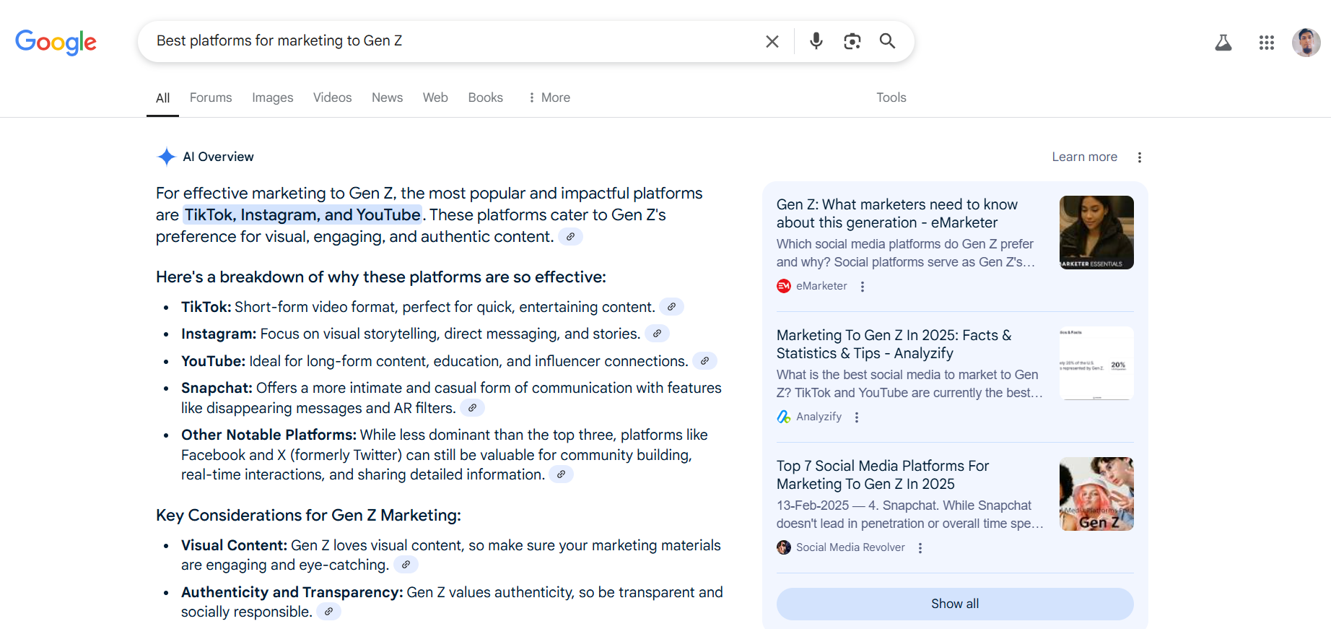
Identify Key Marketing Channels

Slide 14
Identify Key Marketing Channels
Based on user demographics and competitor strategies, we identified the following marketing channels for Social Connect:
Primary Channels:
Instagram (high Gen Z engagement)
Google Ads (search and app downloads)
Facebook (affordable ads and event promotion)
Secondary Channels:
LinkedIn (professional networking)
TikTok (viral potential among youth)

Slide 15
Week 1:
Research and Campaign Planning
Campaign Goal Setting
○ Define SMART goals (e.g., Increase brand awareness by 20% in 3 weeks, achieve 500 app downloads).
○ Set KPIs such as reach, engagement, clicks, or conversions.

Slide 16
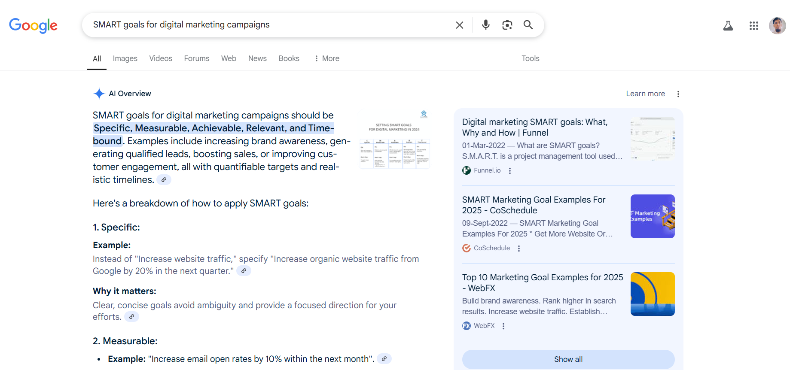
Define SMART goals (e.g., Increase brand awareness by 20% in 3 weeks, achieve 500 app downloads).

Slide 17
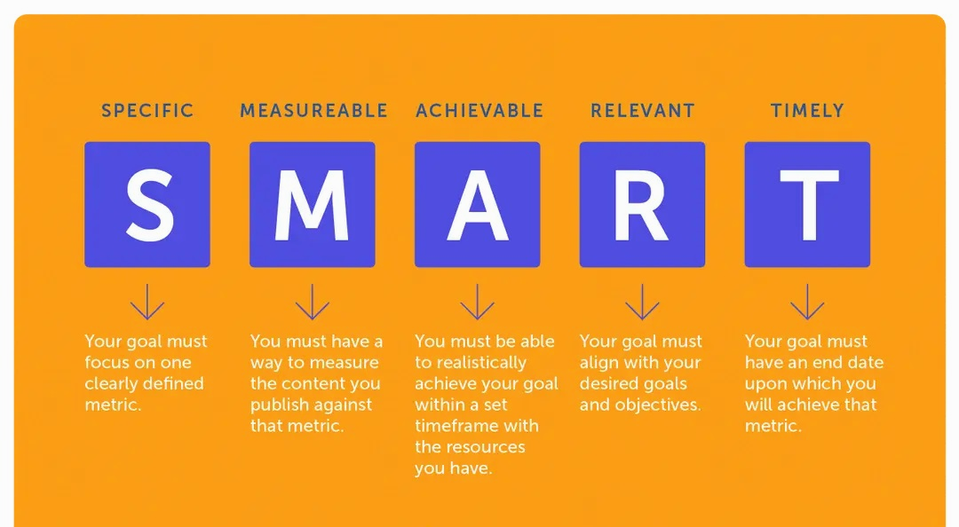
Define SMART goals (e.g., Increase brand awareness by 20% in 3 weeks, achieve 500 app downloads).

Slide 18
Define SMART goals (e.g., Increase brand awareness by 20% in 3 weeks, achieve 500 app downloads).
SMART Campaign Goals for Social Connect:
Increase Instagram followers from 0 to 1,000 in 4 weeks through consistent social media posting and paid ads.
Achieve at least 500 app downloads in 30 days via Google Play Store through targeted ad campaigns.
Reach 10,000 unique users via paid and organic campaigns in 3 weeks to build brand visibility.

Slide 19
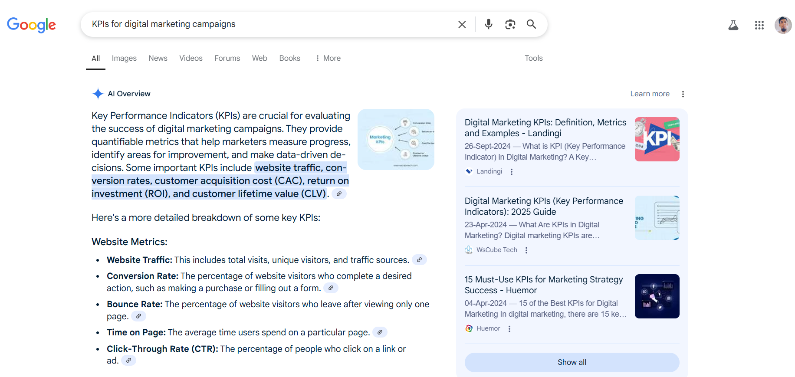
Set KPIs such as reach, engagement, clicks or conversions

Slide 20
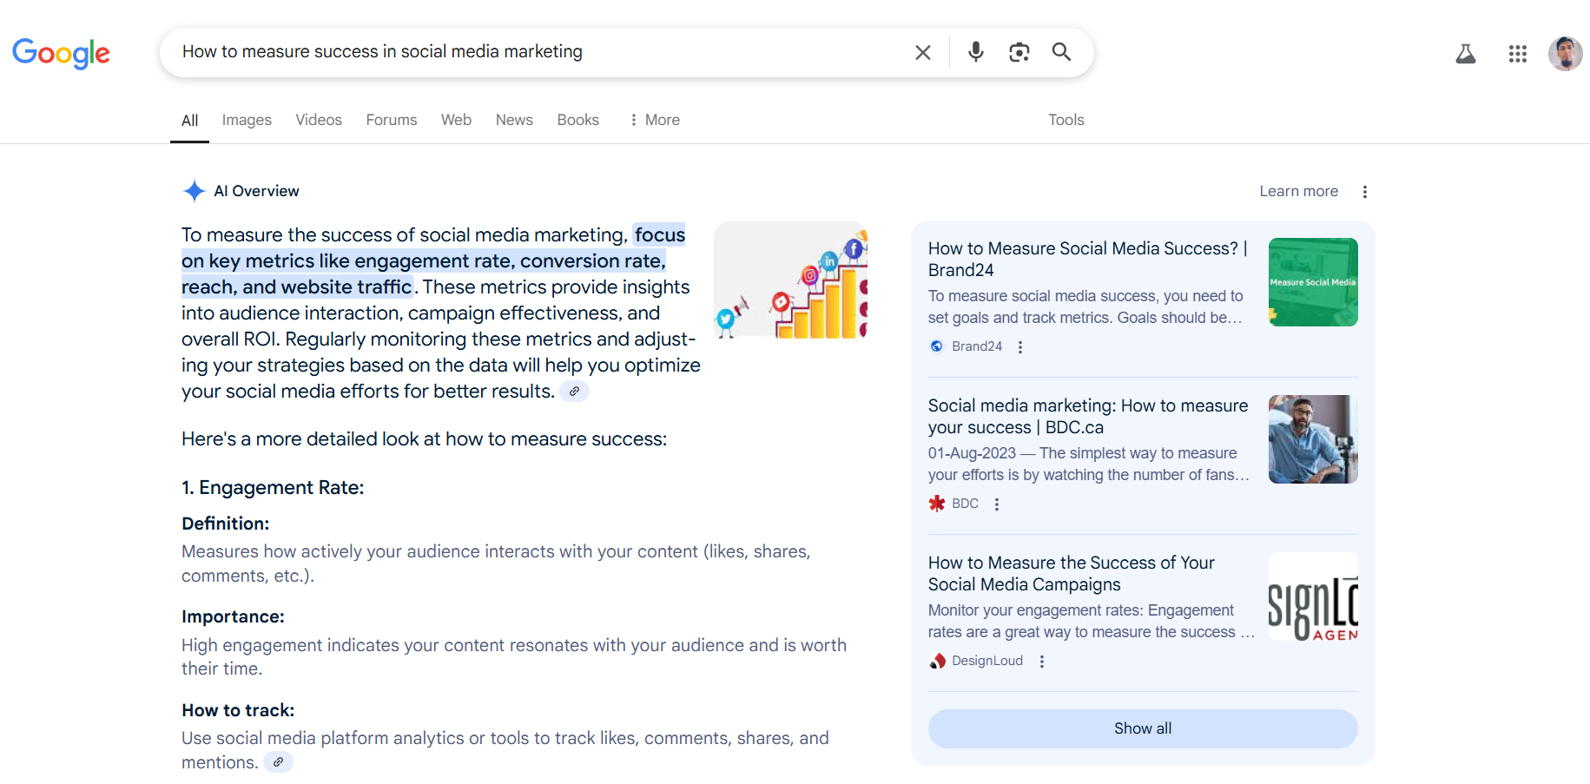
Set KPIs such as reach, engagement, clicks or conversions

Slide 21
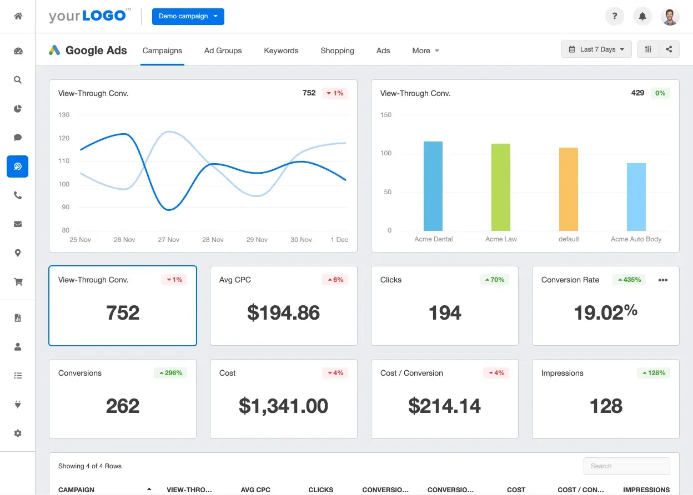
Set KPIs such as reach, engagement, clicks or conversions

Slide 22
Set KPIs such as reach, engagement, clicks or conversions
KPIs are the measurable results you will track to check if the campaign is succeeding. Each SMART goal should have related KPIs.
Key Performance Indicators (KPIs):
Instagram Reach: Total number of unique users who saw the posts/ads
Engagement Rate: Likes, comments, shares per post
Click-Through Rate (CTR): % of people who clicked the ad link
Conversion Rate: % of users who downloaded the app after clicking
App Downloads: Total downloads via campaign channels

Slide 23
Week 1:
Research and Campaign Planning
Content Strategy
○ Plan the type of content to create:
■ Social media posts (graphics, videos, or carousel posts).
■ Blog posts or newsletters.
■ Paid ad copies and creatives.

Slide 24
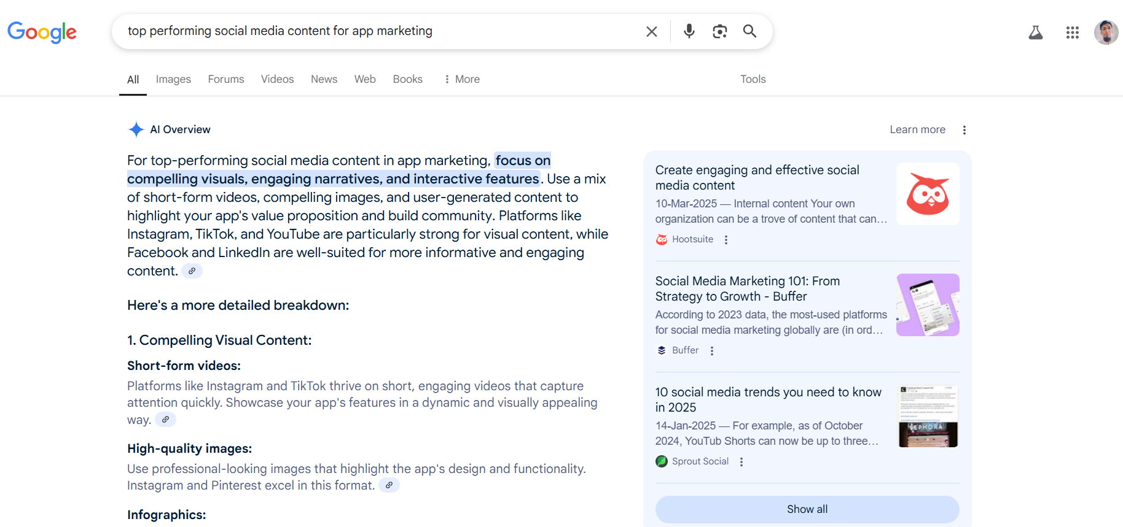
Plan the Type of Social Media Content
Social media posts (graphics, videos, or carousel posts)

Slide 25
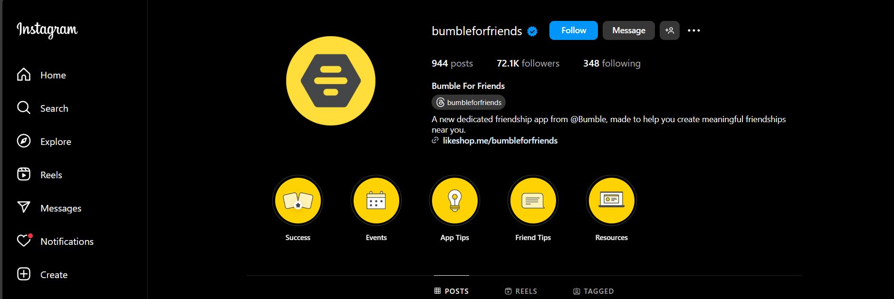
Plan the Type of Social Media Content
Social media posts (graphics, videos, or carousel posts)

Slide 26
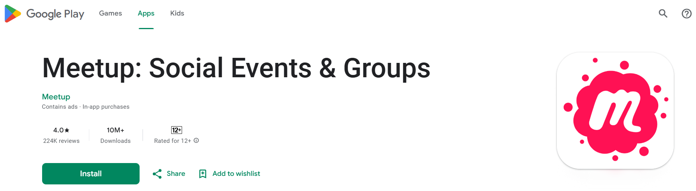
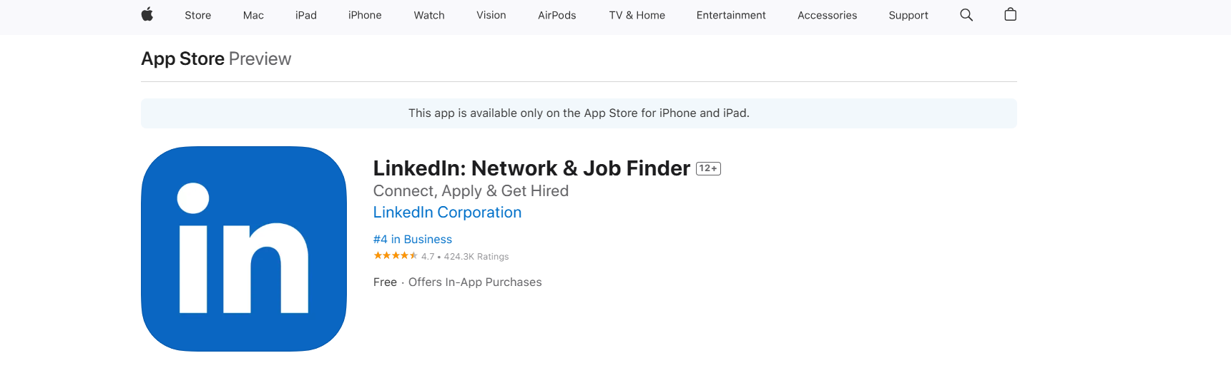
Plan the Type of Social Media Content

Slide 27
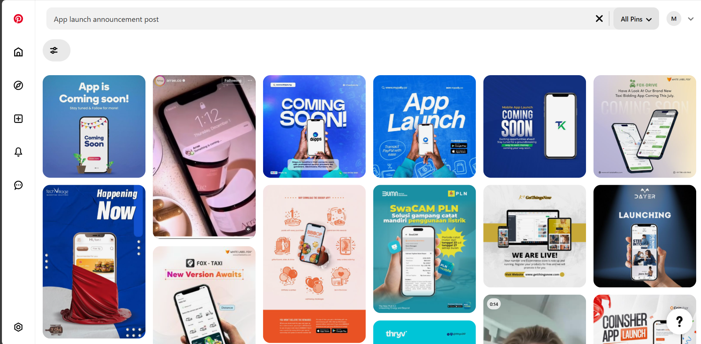
Plan the Type of Social Media Content
Social media posts (graphics, videos, or carousel posts)

Slide 28
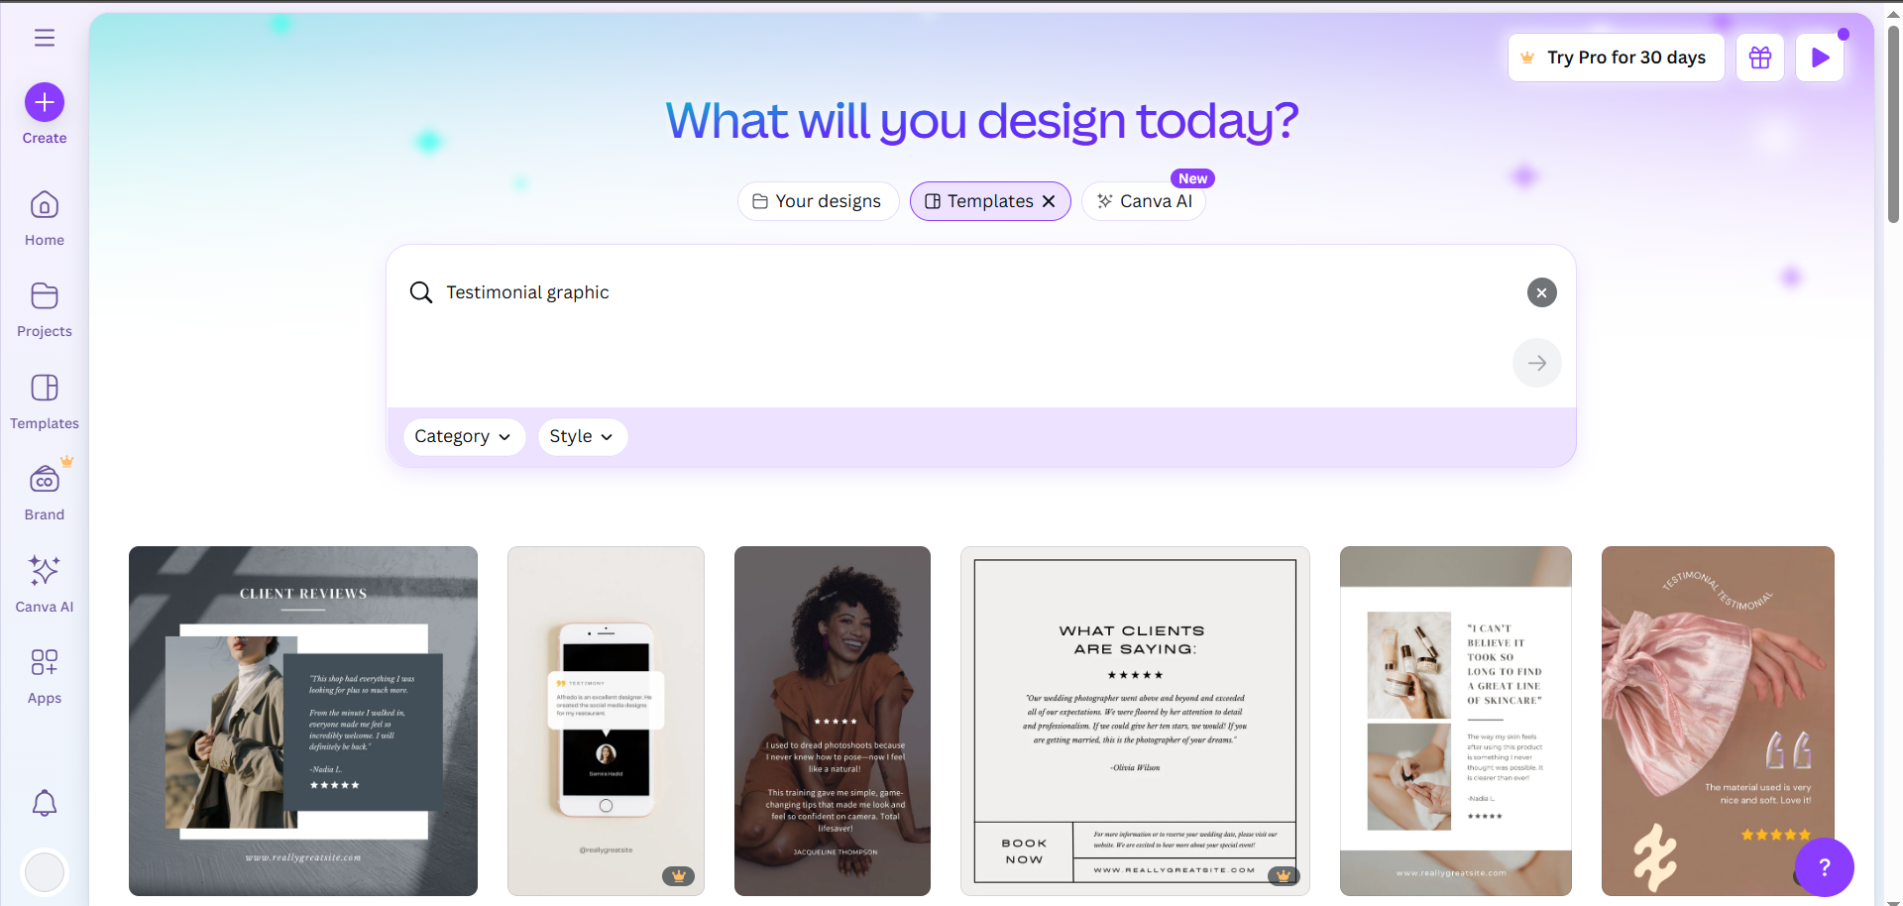
Plan the Type of Social Media Content
Social media posts (graphics, videos, or carousel posts)

Slide 29
Plan the Type of Social Media Content
Social media posts (graphics, videos, or carousel posts)
Planned Social Media Content Types:
Introductory Graphics: Highlight app features and benefits
Short Reels or Explainer Videos: Show how the app works
Carousel Posts: Step-by-step guides, user testimonials, FAQs
Engagement Posts: Polls, quizzes, “Tag a friend” style prompts
Event Promotions: Virtual meetups or community challenges

Slide 30
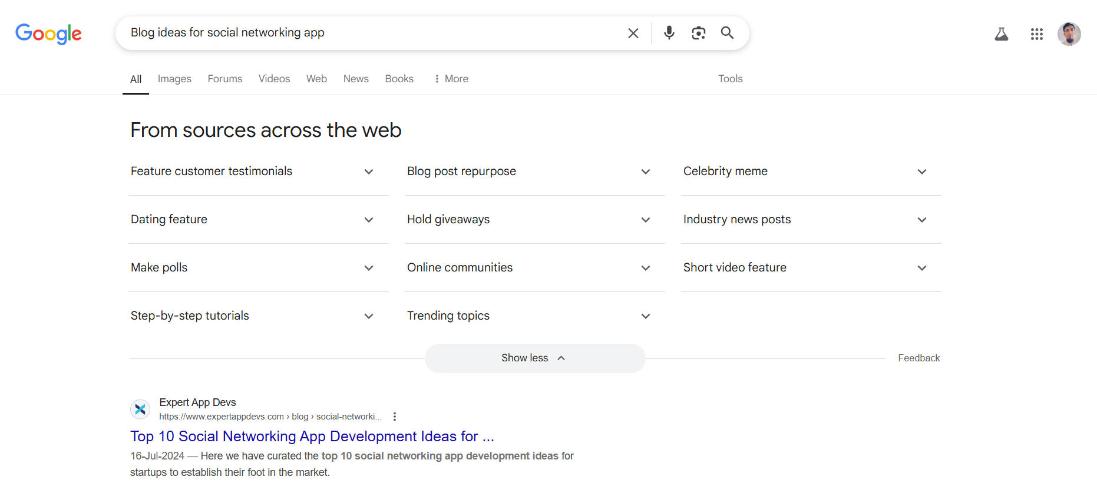
Plan the Type of Social Media Content
Blog post or newsletters.

Slide 31
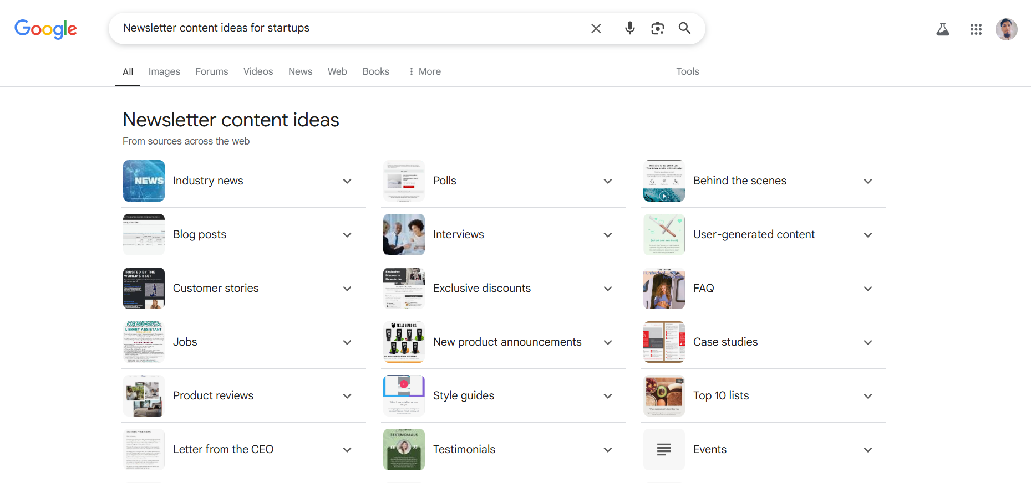
Plan the Type of Social Media Content
Blog post or newsletters.

Slide 32
Plan the Type of Social Media Content
Blog post or newsletters.
https://www.manektech.com/blog/social-media-app-ideas
https://codevian.com/blog/social-media-app-ideas-for-startups/
https://buffer.com/resources/discover-content-ideas/
https://linkitsoft.com/social-media-app-ideas/
https://www.wordstream.com/blog/ws/2021/02/25/email-newsletter-ideas
https://www.campaignmonitor.com/blog/email-marketing/must-have-newsletter-ideas/
https://www.jasper.ai/blog/newsletter-content-ideas
https://staffbase.com/blog/28-employee-newsletter-content-ideas/

Slide 33
Plan the Type of Social Media Content
Blog post or newsletters.
Blog Post & Newsletter Ideas:
Networking Tips for Gen Z Professionals
How to Build Meaningful Friendships Online
User Spotlight: Stories from Our Community
What’s New: Feature Updates from Social Connect
Monthly Recap Newsletter: Highlights, upcoming events, testimonials

Slide 34
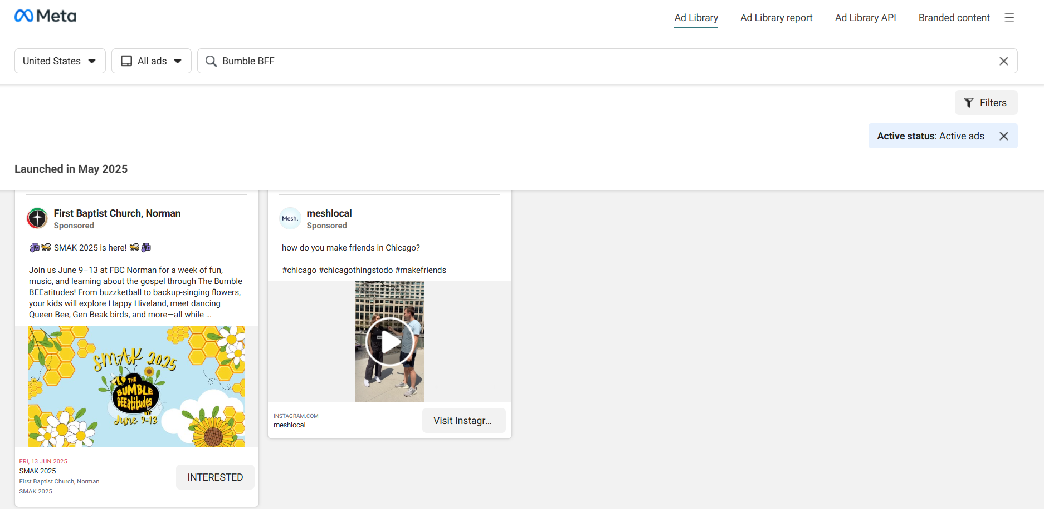
Plan the Type of Social Media Content
Paid ad copies and creatives.

Slide 35
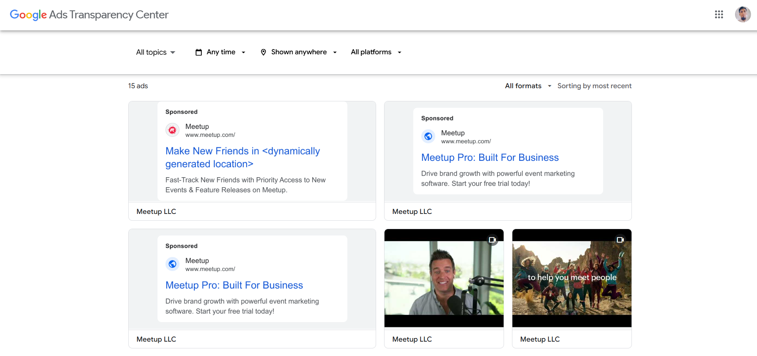
Plan the Type of Social Media Content
Paid ad copies and creatives.

Slide 36
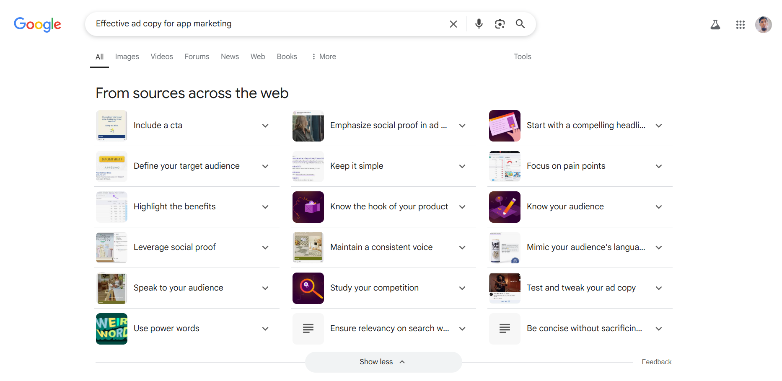
Plan the Type of Social Media Content
Paid ad copies and creatives.

Slide 37
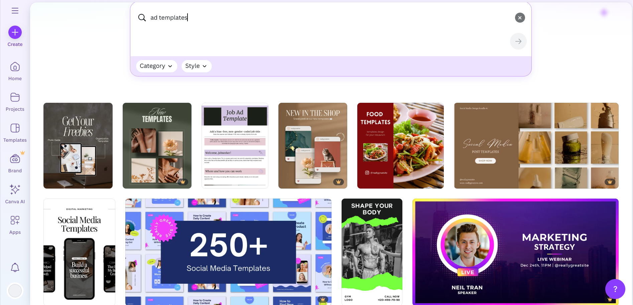
Plan the Type of Social Media Content
Paid ad copies and creatives.

Slide 38
Plan the Type of Social Media Content
Paid ad copies and creatives.
https://www.wordstream.com/blog/ws/2016/05/23/facebook-ad-examples
https://klientboost.com/facebook/facebook-ad-examples/
https://zapier.com/blog/google-ad-examples/
https://www.engagebay.com/blog/google-ad-examples/
https://megadigital.ai/en/blog/mobile-ad-examples/

Slide 39
Plan the Type of Social Media Content
Paid ad copies and creatives.
Ad Copy Ideas:
“Find your tribe with Social Connect! Discover real connections today.”
“Tired of endless scrolling? Join events, connect meaningfully — Download Now.”
“The smarter way to network! Build your future with Social Connect.”
Creative Ideas:
Bright, colorful app mockups
Faces of diverse users
Short 6-second video with feature highlights
Screenshots of the app UI

Slide 40
Week 1:
Research and Campaign Planning
Approval and Feedback
○ Submit the campaign plan to your team leader for review and feedback.
https://github.com/asimansari2050/Muhammad-Asim---DHC-341---Week-1/

Slide 41

Week 1 Completed

